Slide 1

Can we predict and prevent the onset of seizures?
Behnaam Aazhang
J.S. Abercrombie Professor
Electrical and Computer Engineering
Rice University

Slide 2
Can we learn from signal when they are not Gaussian nor linearly related?
Example

Slide 3
Can we predict and prevent the onset of seizures?
less focus on the application
more emphasize on tools
let’s step back with a few more fundamental questions

Slide 4

How can engineers contribute to medicine
e-health
from collecting data to understanding various disorders
developing therapies
  patient-specific
  episode-specific

Slide 5
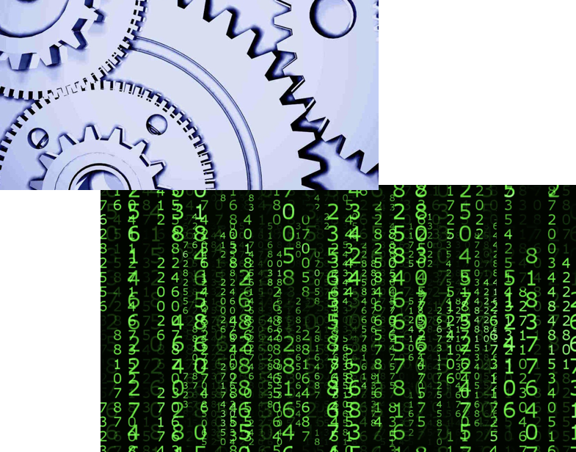
Engineers
problem solving with constraints
developing tools
  sense and measure
    nano-electronics
  control—modulation, stimulation, pacing
    machine learning and data analytics
    nonlinear and non-Gaussian

Slide 6
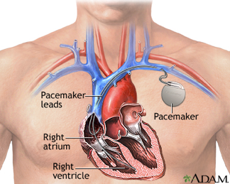
Example
pacemakers

Slide 7
Example
pacemakers
can we modulate our neurological circuit?
  86 billion neurons
    each 10 micron diameter
  100 Hz clock speed
  100 trillion synapses
  complicated functionality with only 20 W of power

Slide 8
One application
epilepsy
  can data analytics predict the onset of seizures?
  can we develop spatiotemporally precise modulation protocols to prevent the onset of seizures?

Slide 9
Epilepsy
unprovoked and recurring seizures
seizure
  no standard definition
  abnormally hyper-excited neuronal activities

Slide 10
Epilepsy
1% of world’s population
causes: stroke, tumors, infection, genetic, …
1/3 of patients do not respond to medication
  resection!!!!!
  deep brain stimulation?

Slide 11
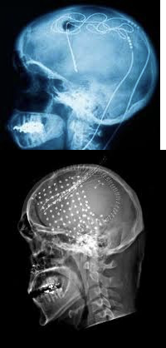

Slide 12
Challenges
identify seizure onset zone in focal seizure
  6-10 electrodes among 250
predict the onset of seizure
  identify pre-ictal from inter-ictal
prevent the onset with modulation???

Slide 13
Challenges
identify seizure onset zone in focal seizure
  6-10 electrodes among 250
predict the onset of seizure
  identify pre-ictal from inter-ictal
prevent the onset with modulation???

Slide 14
ictal

Slide 15
inter-ictal

Slide 16
pre-ictal

Slide 17
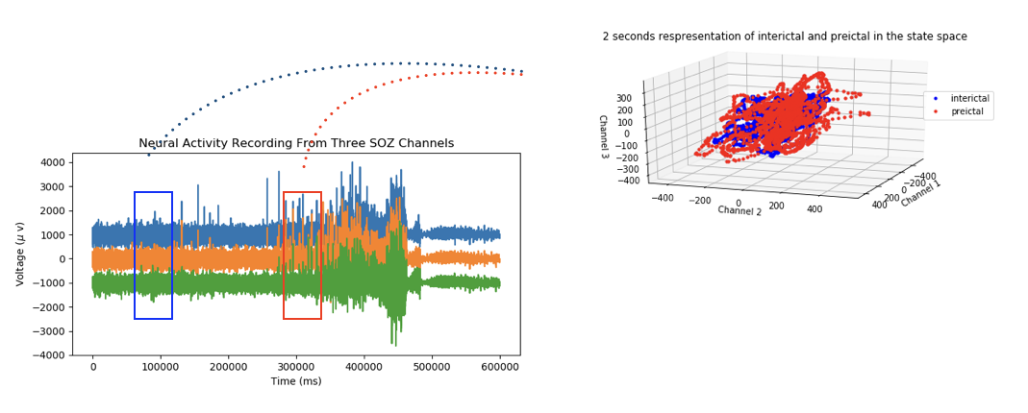
Dynamics of time series
trajectory is nonlinear
inter-ictal and pre-ictal periods are not distinguishable

Slide 18
Dynamics
capturing dynamics of recordings
K recordings in time m are
a linear approximation is often insufficient to capture the dynamics

Slide 19
Time embedding
dynamics result in
a linear approximation has shown to be sufficient in many applications

Slide 20
Embedded dynamic mode decompostion
Extract the dynamics from data
Extract key features from data to capture changes in the state

Slide 21
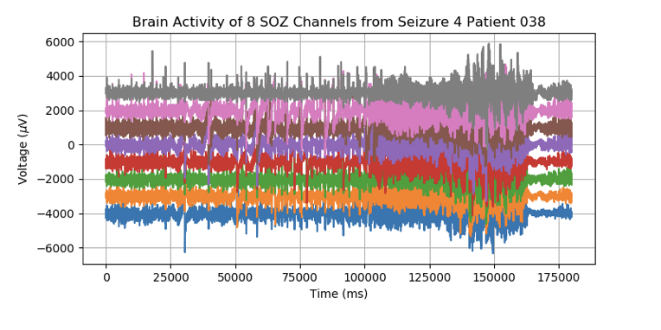




Slide 24
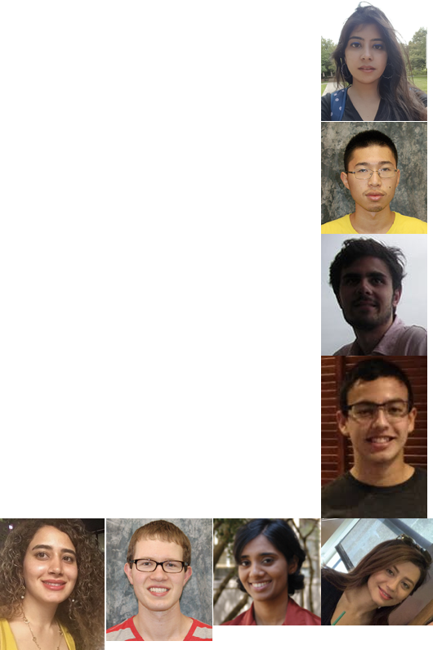
What am I excited about?
non-invasive deep brain stimulation
wireless multisite modulation of the diseased heart
real-time closed-loop modulation for depression
learning and socialization in primates
understanding olfactory circuit
modulation of epileptic circuit

